Slide 1
Platinum Data Project Wang Biyuan
2016.07.19 Presentation

Slide 2
Project Progress
Step I: Import data into MATLAB 【Done】
Step II: Data interpolation 【Processing】
Step III: Data average 【To be done】

Slide 3
Project Progress
Step I: Import data into MATLAB
Key information: 1) Number of measurements
2) Field size
3) Begin/ End position
Notes:
File format for now: asc and mcc
Both can be opened by notepad, in another word, can be read as txt file

Slide 4
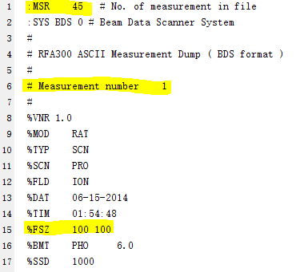
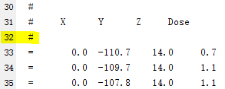
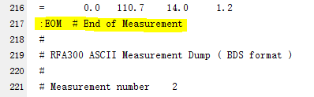
Project Progress: Stage I
File format: .asc
1) Number of measurements
2) Field size
3) Begin/ End position
Notes:
The number of lines between useful information is fixed
Each time when I want to find a particular piece of information, it is simply to skip a certain number of lines and take it

Slide 5
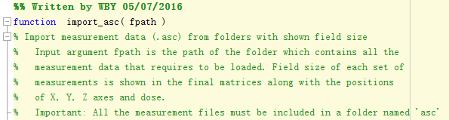
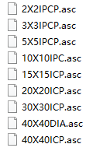
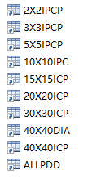
Project Progress: Stage I
Input: File path
Output: A set of extracted data in .mat format
Notes:
By loop to go over all the files in the folder and extract measurement data from each of the file

Slide 6
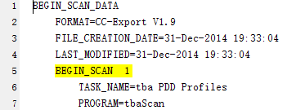
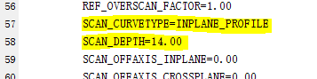



Project Progress: Stage I
File format: .mcc
1) Number of measurements
2) Field size & Depth (for profile) & Scan curve type
3) Begin/ End position
Notes:
Several loops to extract each type of info and put them in different arrays
Then when a set of measurement data was extracted, can match the index of the title info arrays to that set

Slide 7
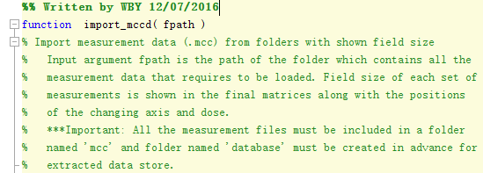
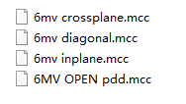

Project Progress: Stage I
Input: File path
Output: A set of extracted data in .mat format

Slide 8
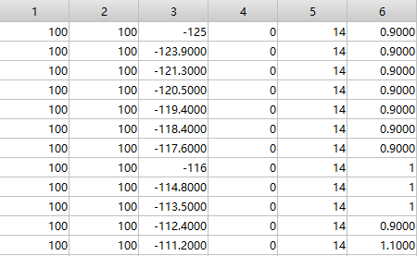
Project Progress: Stage I
Final Database
Field size Field size X Y Z Dose

Slide 9

Project Progress
Step II: Data Interpolation
Aim: ensure the consistency of data length
400
400
400
Notes:
By either truncation or interpolation

Slide 10
Project Progress
Step II: Data Interpolation
Operation: out=interp1(y, xp, method)
y: Sample values
xp: Query points
method: Interpolation method

Slide 11


Project Progress
Step II: Data Interpolation Example
out=interp1(y, xp, method)
y: Sample values
Independent variable axis
Dose
xp: Query points
method: Interpolation method
1: 0.1 : No. samples
e.g. No. samples=210
xp=1:0.1:210
Independent variable axis:
‘Linear’
Dose:
‘Nearest’

Slide 12
Project Progress
Step II: Data Interpolation
out=interp1(y, xp, method)
post interpolation process:
Matrix Recombination
Output of interpolation: two single arrays
Extend other variables to the new length to keep matrix dimensions consistent
2) Sanity Check
Find the dose corresponding to the axis in the raw data from interpolated dataset
Whether the difference between these two sets is zero

Slide 13
Project Progress
Step III: Data Average
Site 1
Site 2
Site n
mean
...

Slide 14
Future Work Plan
The standard data length (according to the type of measurement)
Tweak the interpolation method
Check the reliability of averaged data by comparing with raw data plot

Slide 15
THE END Thank you for your patience!

